Slide 1
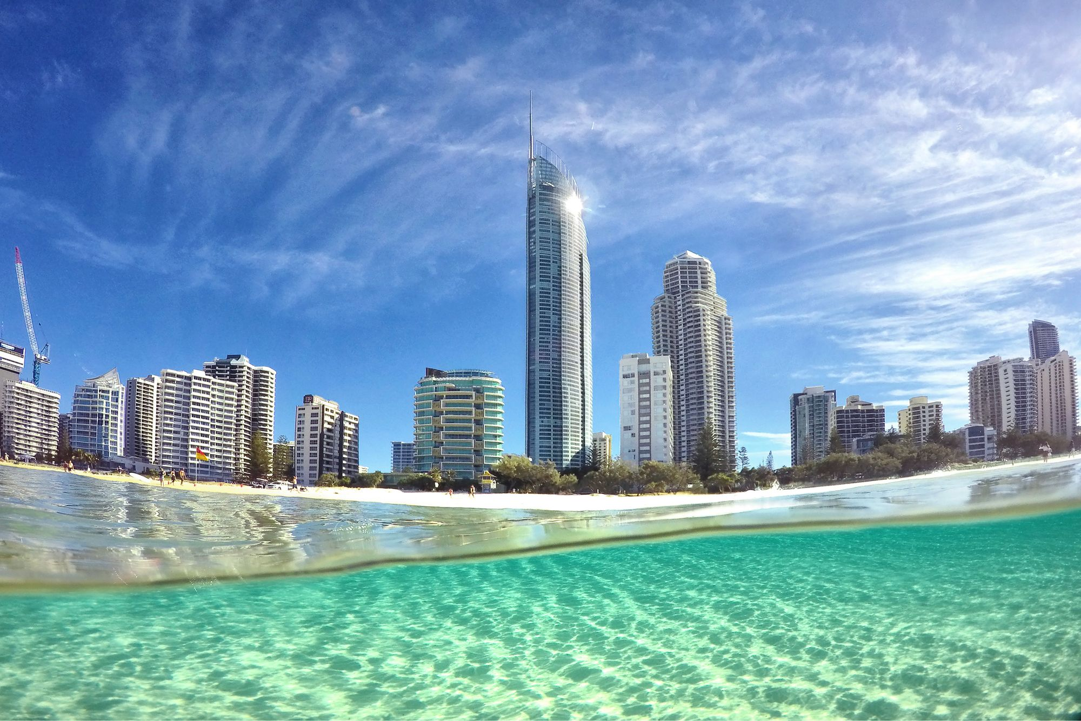

Slide 2


Slide 9
Change Image

Slide 10
Change Image

